Slide 1
Before your volunteers begin collecting data
Think about answering the questions:
  Who?
  What?
  Where?
  When?
  Why?
  How?
Notes:
Before you send your volunteer monitors out to a lake or stream to collect data, you should think about the potential answers to the 5Ws and 1H – Who, What, When, Why, Where and How.
The questions that you should be addressing help you to determine what you should be monitoring. You generally cannot just be “concerned about water quality”. Instead you need to know specific answers about what you’re interested in learning in your sampling.

Slide 2
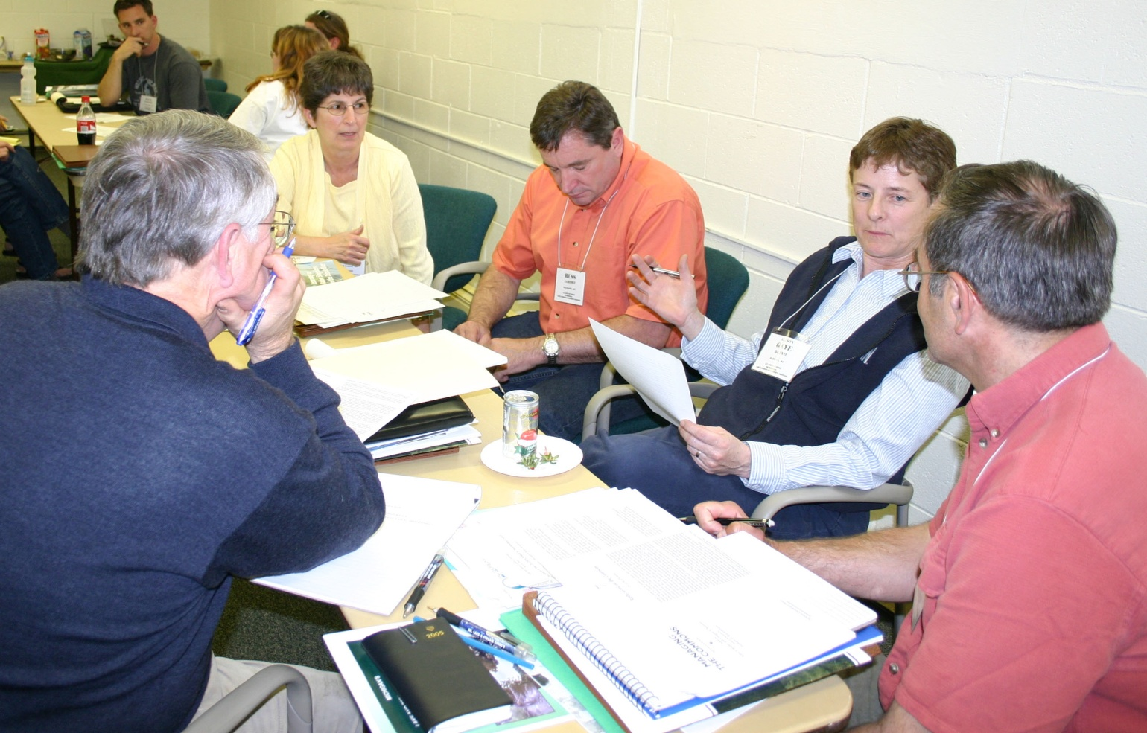
Before your volunteers begin collecting data
Why are you monitoring? (goal of the study)
Notes:
We’ll begin with the Why.
One of the first questions you and your volunteers should be asking is Why am I monitoring? If you’re not clear on this don’t start. A watershed survey can help answer or clarify this question. Have there been any previous monitoring efforts in the watershed you’ve selected? If yes, what methods, procedures and protocol were used? Try to gather as much information as you can prior to going out and sampling. You may save yourself time and money by reviewing what’s already been done.

Slide 3
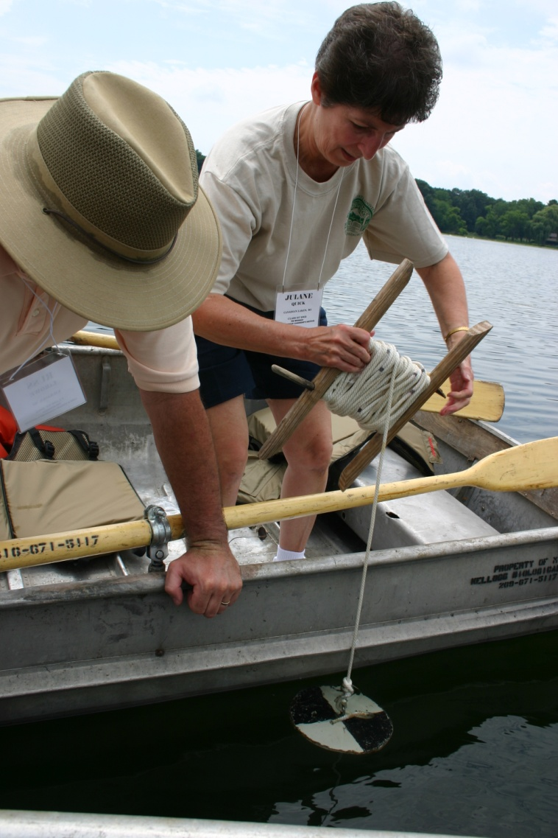
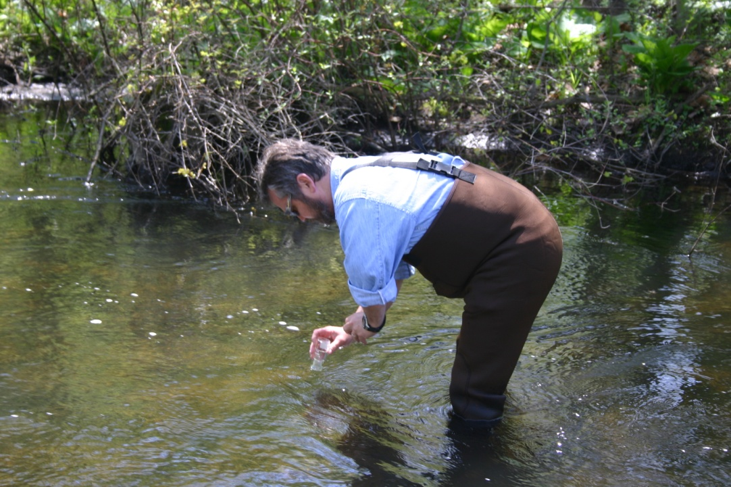
Who will be using your data?
  State or local agencies
  Screening purposes
  Educational
Notes:
The next question concerns Who will be using the data? In some states there is no clear mechanism for the use of volunteer generated data in land use decision making or regulatory action. In other states, volunteer programs are encouraged to send their data to state agencies. It may be used for screening purposes and serve as a red flag for state agencies to conduct further investigation. However, most volunteer data are used for educational purposes and in some educational efforts, the actual data may be secondary to the data collection process.
3

Slide 4
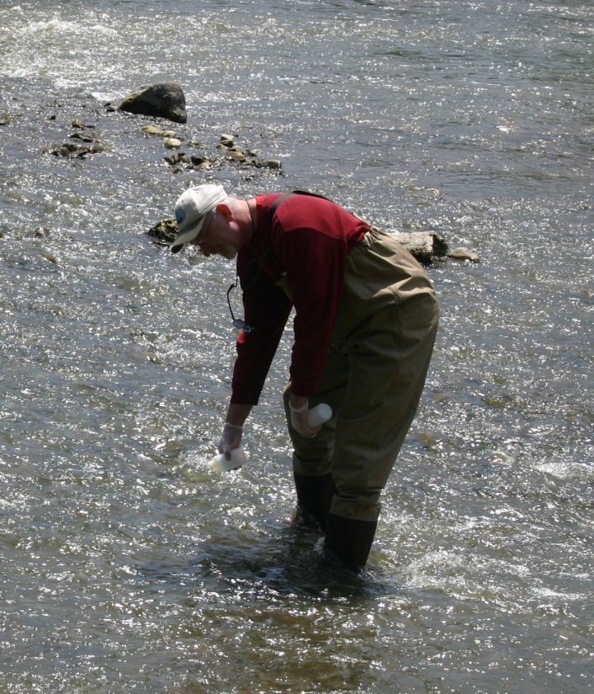
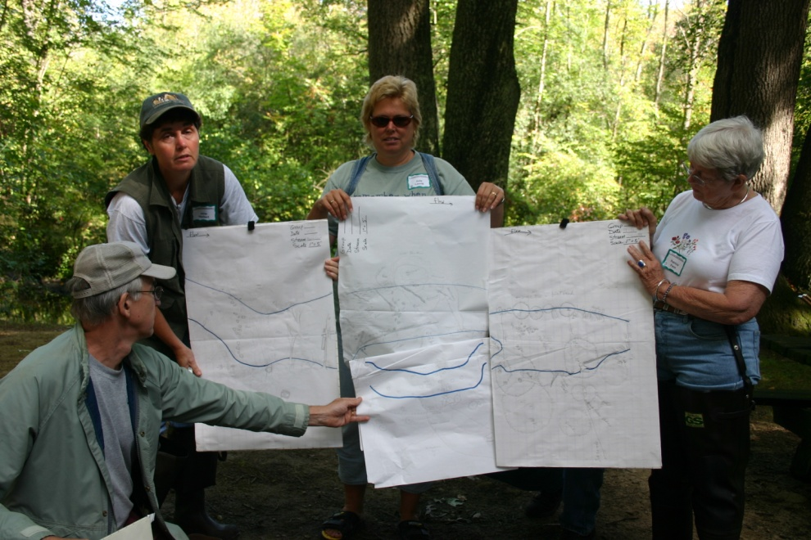
What are you trying to assess and measure?
EPA’s List of 20 Common Parameters
Water temperature
pH
Dissolved Oxygen
Macroinvertebrates
Debris clean-up
Habitat assessments
Nitrogen
Phosphorus
Turbidity
Coliform bacteria
Secchi depth
Aquatic vegetation
Flow
Birds/Wildlife
Fish
Watershed mapping
Rainfall
Photographic surveys
Salinity
Sediment assessments
Notes:
The What question concerns knowing what you want to learn from your monitoring. This in turn will help you determine the parameters that you should be measuring or the conditions you want to study. The EPA lists the top 20 parameters that are monitored in volunteer monitoring programs. While you likely will not measure all of these, you should know what in particular you’re interested in learning about the water.
For example, you might be interested in knowing what the influence of a near-stream development site is on streamflow and habitat. In this case you’ll likely need to measure the discharge of the stream, assess the habitat, and perhaps learn about the current land use in the watershed.
If you’re interested in knowing if the stream is safe for human contact you may want to measure fecal coliform to determine if bacteria levels are meeting standards for total body contact.
4

Slide 5
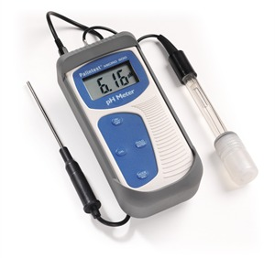
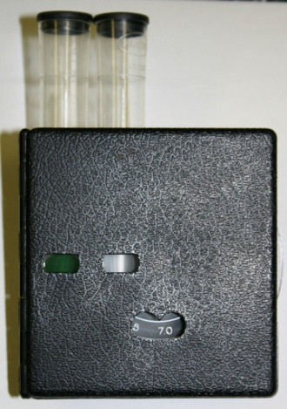
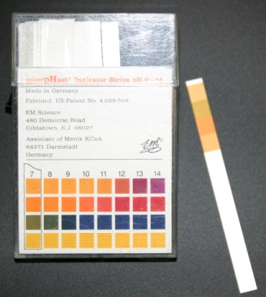
How will you be collecting the data (methods and procedures)
Methods Used
Sensitivity of Equipment
Number of Samples
Possible options for measuring pH
Notes:
How will you go about collecting information about the parameters you want to measure? You’ll need to determines what method will be used to sample and the procedure for using that method?
For example, you need a pH measurement to find out the acid level of the water your monitoring. Since pH is on a logarithmic scale, you’ll need to determine if a color comparator is sensitive enough or do you need to purchase a more expensive meter? For your procedure in sampling, will your measurements be taken at surface or some fraction of the depth? Will you take one sample in the middle of the stream channel or will you need to take measurements at the left, center and right portions of the stream. If you’re on a lake, do you need multiple samples from top to bottom or will just one do. Once again, these question should be answered after you revisit your goals, determine the quality of data necessary, and know who will be using the data.
5

Slide 6
Where and when should you sample? (location and sites; sampling frequencies)
Upstream of the event
Downstream of the event
Notes:
Where should you sample, when should you go out, and for what time period?
You and your volunteers should be able to determine the sampling locations and sites that will produce the information of interest and reduce extraneous influences and wasted effort. You should also consider stream or lake access. Do you need permission from a riparian owner or can you access the stream on public lands.
Depending on your answers, you may want to sample upstream and downstream from a particular site; it might be before and after some development is put in place. It might be above the confluence of a river and below it. Or, you may decide that just one location will be sufficient.
6

Slide 7
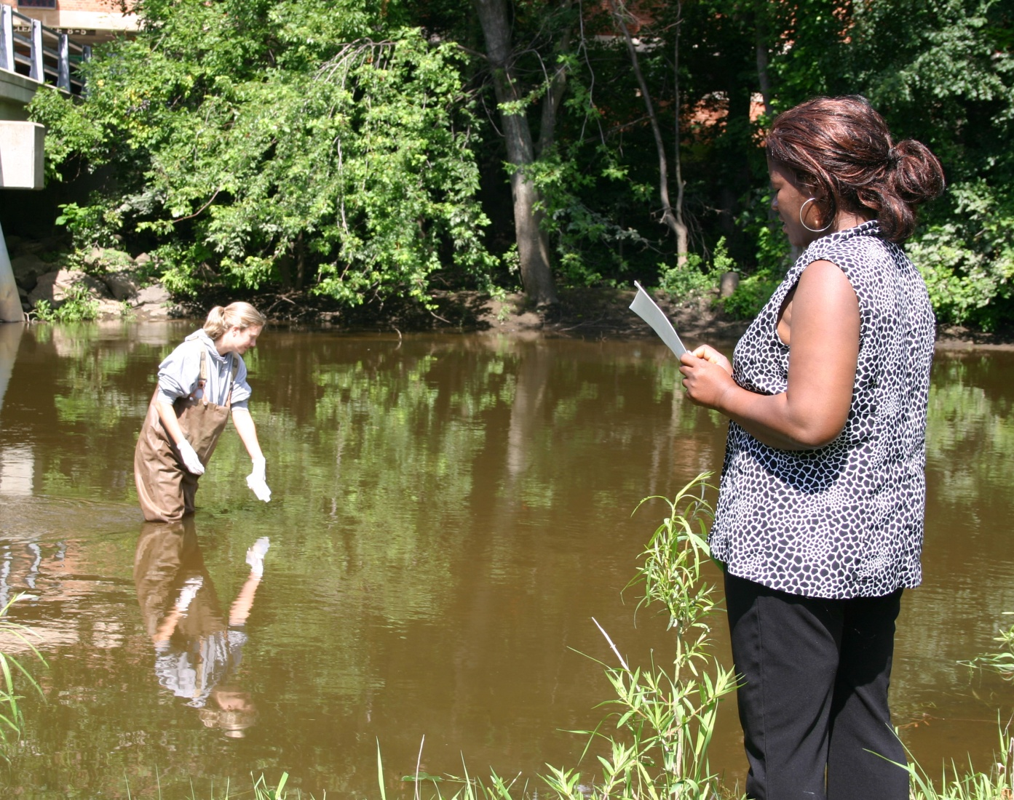
When and how often should you sample? (location and sites; sampling frequencies)
Notes:
When and How often and what time of day should you sample? Some volunteer programs have their volunteers sample once in the spring and once in the fall. For some programs, you might include event monitoring, for example, during or after a storm. Physical and chemical parameters can be measured monthly, quarterly or even hourly if monitoring a specific event. The time of day should also be considered.
You also should plan for the length of time for the entire sampling program. This will depend on many factors including volunteer time, money, and the questions being asked. It might take 2 – 3 years of baseline monitoring to assess natural variation that occurs over time in stream systems. Time of year and seasonal changes may also influence your protocols for the overall sampling time.

Slide 8
The U.S. Environmental Protection Agency's (EPA) Office of Water says:
“Volunteer monitors build awareness of pollution problems, become trained in pollution prevention, help clean up problem sites, provide data for waters that may otherwise be unassessed, and increase the amount of water quality information available to decision makers at all levels of government.”
Visit EPA’s Monitoring and Assessing Water Quality - Volunteer Monitoring at: http://water.epa.gov/type/rsl/ datait/waters/georef/epasvmp.cfm for a variety of resources including field methods manuals for lakes and streams
Notes:
The U.S. Environmental Protection Agency's (EPA) Office of Water says:
“Volunteer monitors build awareness of pollution problems, become trained in pollution prevention, help clean up problem sites, provide data for waters that may otherwise be unassessed, and increase the amount of water quality information available to decision makers at all levels of government.”
These aspects of volunteer monitoring are critical to your community, region, and state
Visit EPA’s Monitoring and Assessing Water Quality - Volunteer Monitoring at the web site listed on this page for a variety of resources including field methods manuals for lakes and streams.

Slide 9
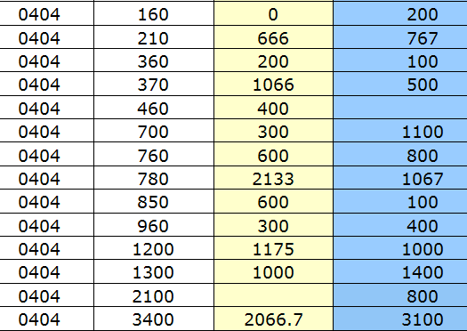
Now you’re ready to collect your data
In the next step, we’ll discuss collecting various types of data, data analysis and interpretation and managing your data
Notes:
Now you’re ready to collect your data. In the next step, we’ll discuss collecting various types of data, data analysis and interpretation and managing your data.

